Slide 1
Diversity-weighted Portfolio in Stochastic Portfolio Optimization
Chenghao Zhu, Yuxuan Zhou, Haoyang Shang, Yuhan Wang

Slide 2

What We do
Utilized Diversity-weighted Portfolios to solve inverse problems
Assessed Frequentist vs. Bayesian inference performance
Compared postivie and negative parameters in DWP

Slide 3

Overview of Stochastic Portfolio Theory (SPT)
Developed by Robert Fernholz in 2002
Focuses on outperforming the market index with a high probability

Slide 4

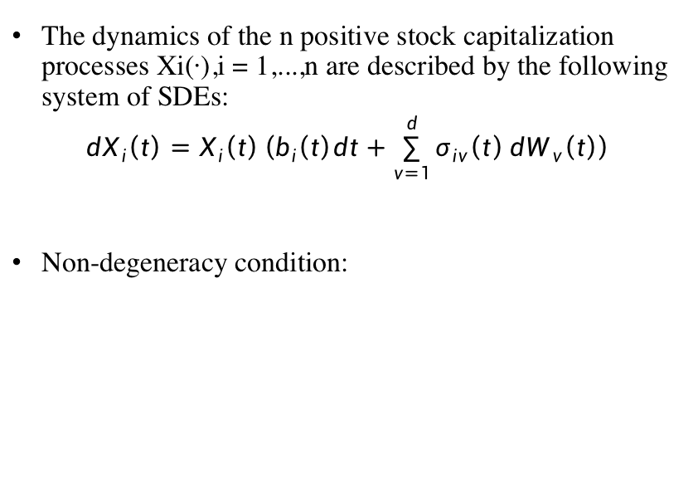
Stock market
The dynamics of the n positive stock capitalization processes Xi(·),i = 1,...,n are described by the following system of SDEs:
$$dX_{i}\left(t\right)=X_{i}\left(t\right)\left(b_{i}\left(t\right)dt+\sum_{v=1}^{d}{σ_{iv}\left(t\right)}dW_{v}\left(t\right)\right)$$
Non-degeneracy condition:

Slide 5

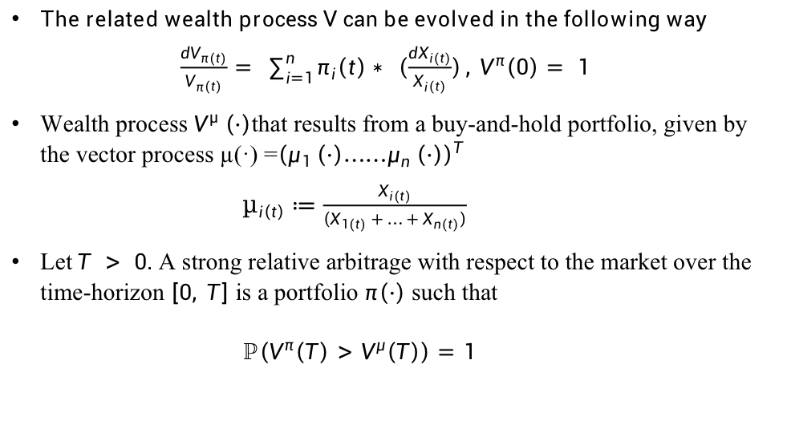
Relative Arbitrage
The related wealth process V can be evolved in the following way
$\frac{dV_{π\left(t\right)}}{V_{π\left(t\right)}}= \sum_{i=1}^{n}{π_{i}\left(t\right)}∗ \left(\frac{dX_{i\left(t\right)}}{X_{i\left(t\right)}}\right), V^{π}\left(0\right)= 1$
Wealth process $V^{μ} \left(·\right)$that results from a buy-and-hold portfolio, given by the vector process µ(·) =${\left(μ_{1} \left(·\right){……μ}_{n} \left(·\right)\right)}^{T}$
$µ_{i\left(t\right)}≔\frac{X_{i\left(t\right)}}{\left(X_{1\left(t\right)}+ … + X_{n\left(t\right)}\right)}$
Let$T > 0.$ A strong relative arbitrage with respect to the market over the time-horizon $\left[0, T\right]$ is a portfolio $π\left(·\right)$ such that
$ℙ\left(V^{π}\left(T\right)>V^{μ}\left(T\right)\right)=1$

Slide 6
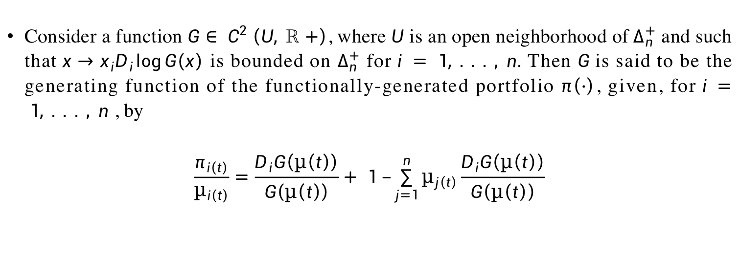
Functionally-generated portfolios
Consider a function $G∈ C^{2} \left(U, ℝ+\right)$, where$U$ is an open neighborhood of${ Δ}_{n}^{+}$ and such that$x→x_{i}D_{i}\log{G\left(x\right)}$ is bounded on $Δ_{n}^{+}$ for$i = 1, . . . , n.$ Then $G$is said to be the generating function of the functionally-generated portfolio $π\left(·\right)$, given, for$i = 1, . . . , n$ , by
$$\frac{π_{i\left(t\right)}}{µ_{i\left(t\right)}}=\frac{D_{i}G\left(µ\left(t\right)\right)}{G\left(µ\left(t\right)\right)}+ 1 –\sum_{j=1}^{n}{µ_{j\left(t\right)}\frac{D_{i}G\left(µ\left(t\right)\right)}{G\left(µ\left(t\right)\right)}}$$

Slide 7
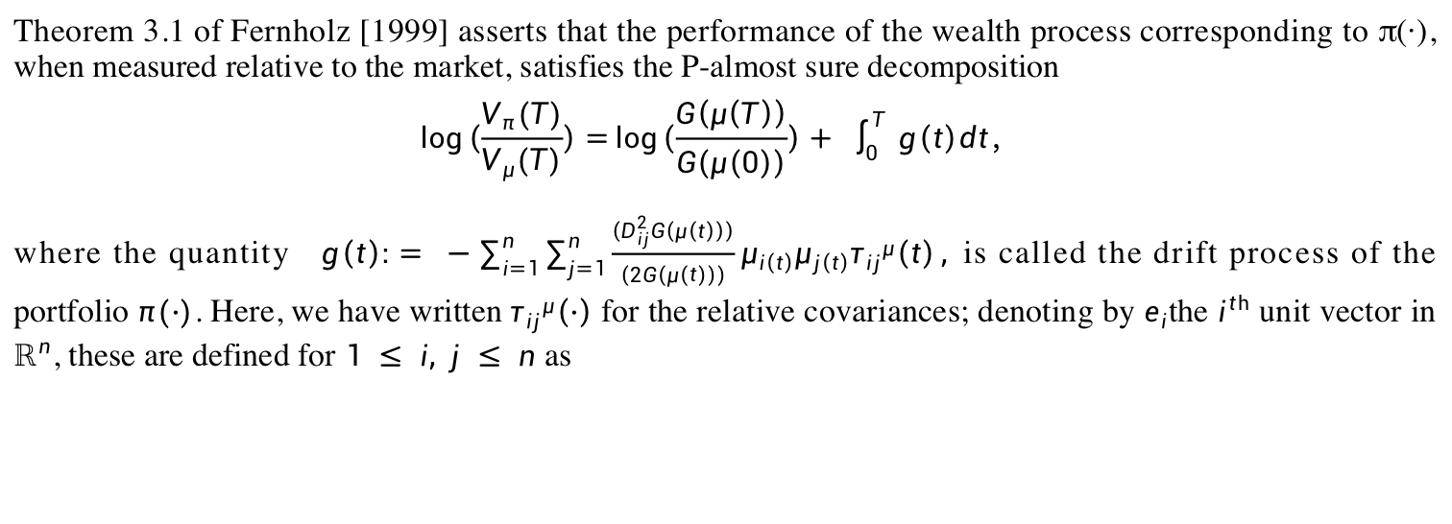
Functionality-generated portfolios
Theorem 3.1 of Fernholz [1999] asserts that the performance of the wealth process corresponding to π(·), when measured relative to the market, satisfies the P-almost sure decomposition
$$\log\left(\frac{V_{π}(T)}{V_{μ}(T)}\right)=\log\left(\frac{G\left(μ\left(T\right)\right)}{G\left(μ\left(0\right)\right)}\right)+ \int_{0}^{T}{ g\left(t\right)dt， }$$
where the quantity $g\left(t\right):= −\sum_{i=1}^{n}{\sum_{j=1}^{n}{\frac{\left(D_{ij}^{2}G\left(μ\left(t\right)\right)\right)}{\left(2G\left(μ\left(t\right)\right)\right)}}μ_{i\left(t\right)}μ_{j\left(t\right)}{τ_{ij}}^{μ}\left(t\right)},$is called the drift process of the portfolio $π(·)$. Here, we have written${τ_{ij}}^{μ}\left(·\right)$ for the relative covariances; denoting by $e_{i}$the $i^{th}$ unit vector in $ℝ^{n}$, these are defined for $1 ≤ i, j ≤ n$ as

Slide 8
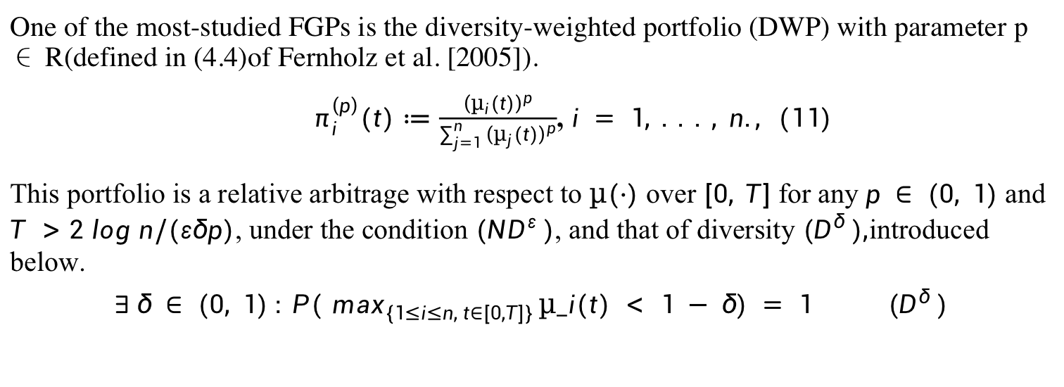
Diversity-weighted Portfolios
One of the most-studied FGPs is the diversity-weighted portfolio (DWP) with parameter p ∈ R(defined in (4.4)of Fernholz et al. [2005]).
$π_{i}^{\left(p\right)}(t)≔\frac{{\left(µ_{i}(t)\right)}^{p}}{\sum_{j=1}^{n}{{\left(µ_{j}(t)\right)}^{p}}}$, $i = 1, . . . , n., (11)$
This portfolio is a relative arbitrage with respect to $µ(·)$ over $[0, T]$for any $p ∈ (0, 1)$ and $T >$ $2 log n/(εδp)$, under the condition $(ND^{ε} )$, and that of diversity $(D^{δ} ),$introduced below.
$$∃ δ ∈ (0, 1) : P(⁡\max_{\{1≤i≤n, t∈[0,T]\} }µ_i(t) < 1 − δ) = 1 (D^{δ} )$$

Slide 9
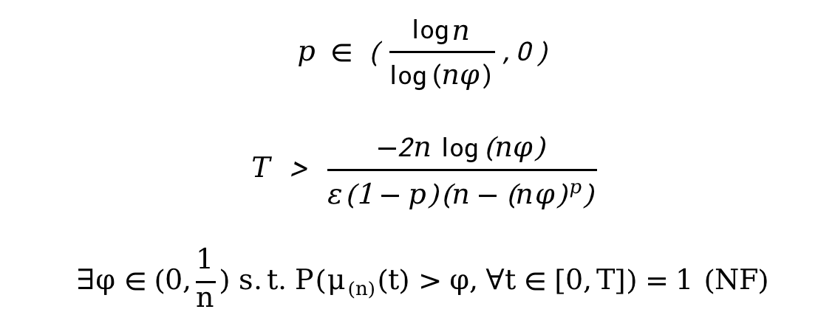
Negative Parameter P
Under strict range and non-failure condition, the diversity-weighted portfolio is a strong arbitrage relative to market.

Slide 10
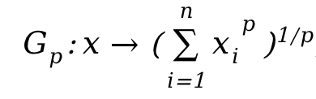
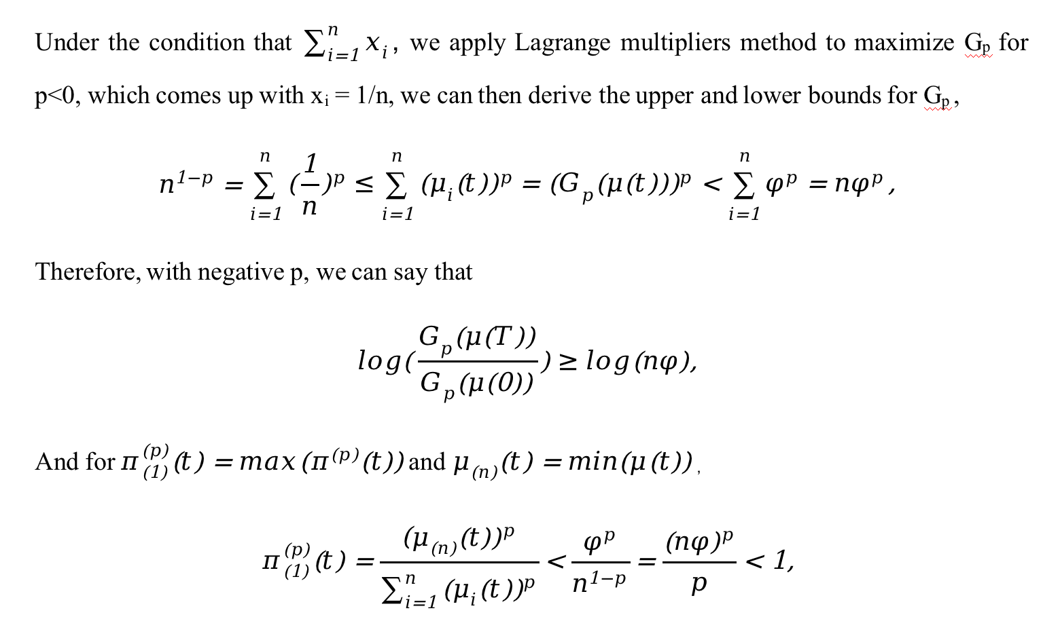
Negative Parameter P
Diversity-weighted portfolios is generated by the function

Slide 11
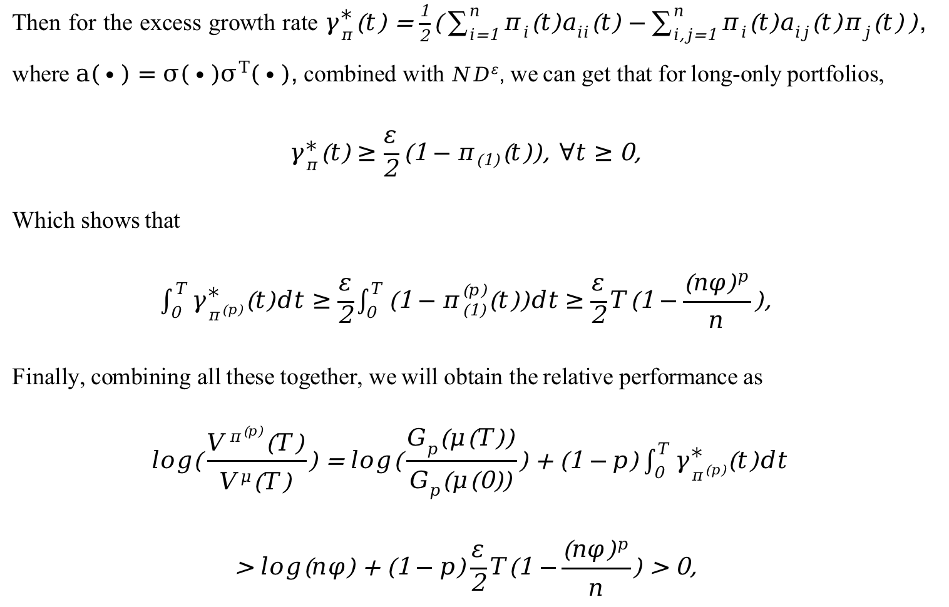
Negative Parameter P

Slide 12
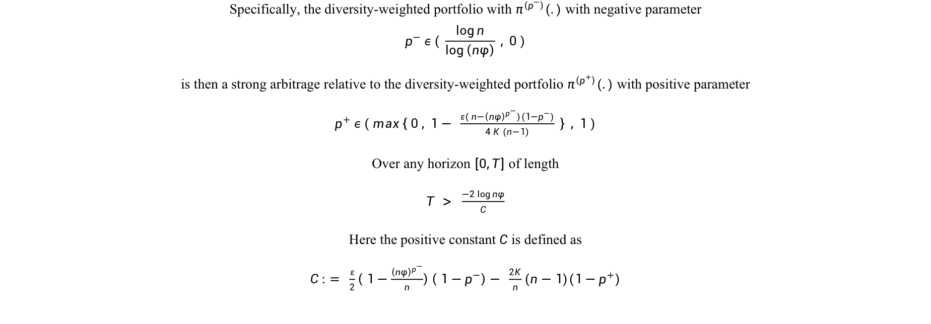
Negative Parameter P over Positive P
Specifically, the diversity-weighted portfolio with $π^{\left(p^{−}\right)}(.)$ with negative parameter
$$p^{−} ε ( \frac{\log{n}}{\log\left(nφ\right)} , 0 )$$
is then a strong arbitrage relative to the diversity-weighted portfolio $π^{\left(p^{+}\right)}(.)$ with positive parameter
$p^{+} ε ( max\left\{ 0 , 1− \frac{ε( n−{\left(nφ\right)}^{p^{−}})(1−p^{−})}{4 K (n−1)} \right\} , 1 )$
Over any horizon $\left[0,T\right]$of length
$T > \frac{−2 \log{nφ}}{C}$
Here the positive constant $C$ is defined as
$C := \frac{ε}{2}\left( 1−\frac{{\left(nφ\right)}^{p^{−}}}{n}\right)\left( 1−p^{−}\right)− \frac{2K}{n}(n−1)(1−p^{+})$

Slide 13
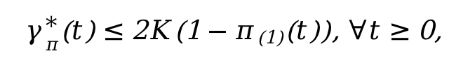
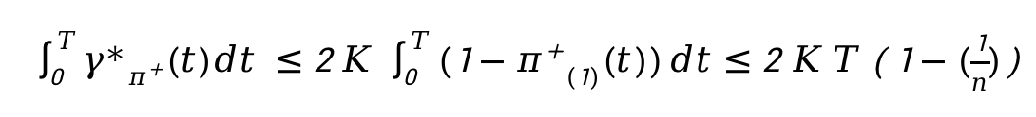
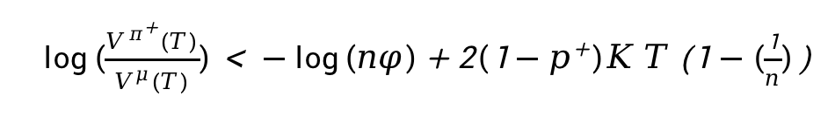
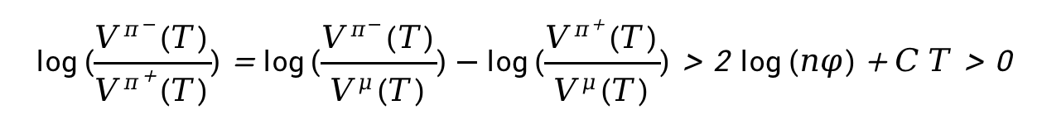
Negative Parameter P over Positive P
Using the bounded variance assumption
We are able to show that
Therefore

Slide 14

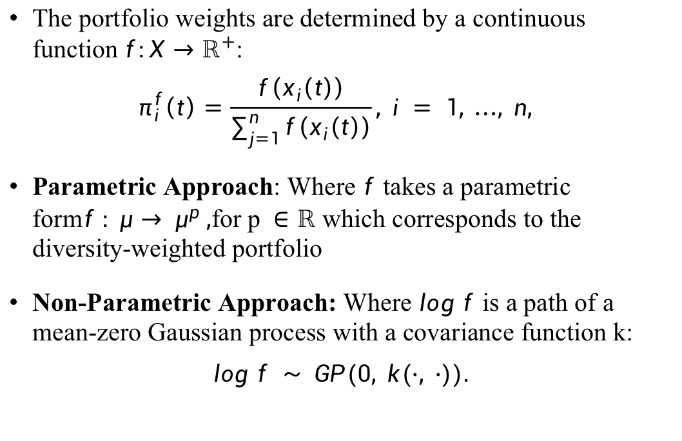
Model Specification
The portfolio weights are determined by a continuous function$f:X→ℝ^{+}$:
$$π_{i}^{f}\left(t\right)=\frac{f\left(x_{i}\left(t\right)\right)}{\sum_{j=1}^{n}{f\left(x_{i}\left(t\right)\right)}}, i = 1, …, n,$$
Parametric Approach: Where $f$ takes a parametric form$f : μ→ μ^{p} ,$for p$∈ℝ$ which corresponds to the diversity-weighted portfolio
Non-Parametric Approach: Where $log f$ is a path of a mean-zero Gaussian process with a covariance function k:
$$log f ∼ GP(0, k(·, ·)).$$

Slide 15
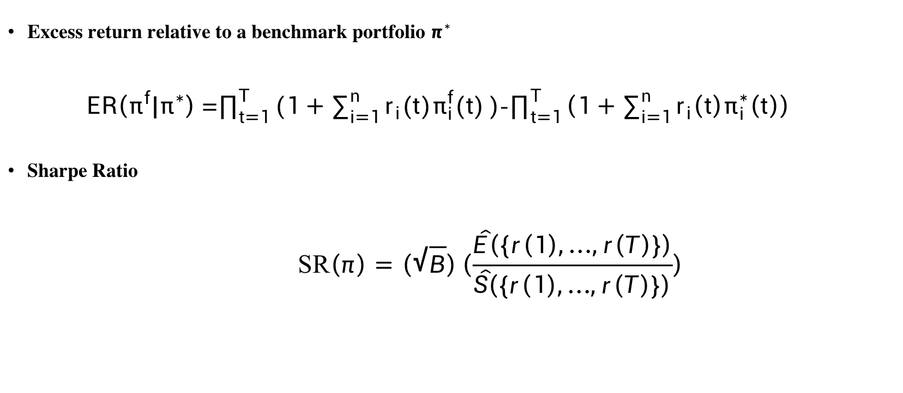
Model Specification – Performance measure
Excess return relative to a benchmark portfolio $π^{∗}$
$ER\left(π^{f}|π^{∗}\right)$ =$\prod_{t=1}^{T}{(1+\sum_{i=1}^{n}{r_{i}(t)π_{i}^{f}(t)})}$-$\prod_{t=1}^{T}{\left(1+\sum_{i=1}^{n}{r_{i}\left(t\right)π_{i}^{∗}\left(t\right)}\right)}$
Sharpe Ratio
$$\text{SR}\left(π\right)=\left(\sqrt{B}\right)\left(\frac{\hat{E}\left(\{r\left(1\right),…,r\left(T\right)\}\right)}{\hat{S}\left(\{r\left(1\right),…,r\left(T\right)\}\right)}\right)$$

Slide 16
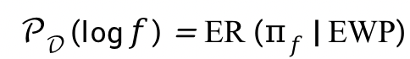
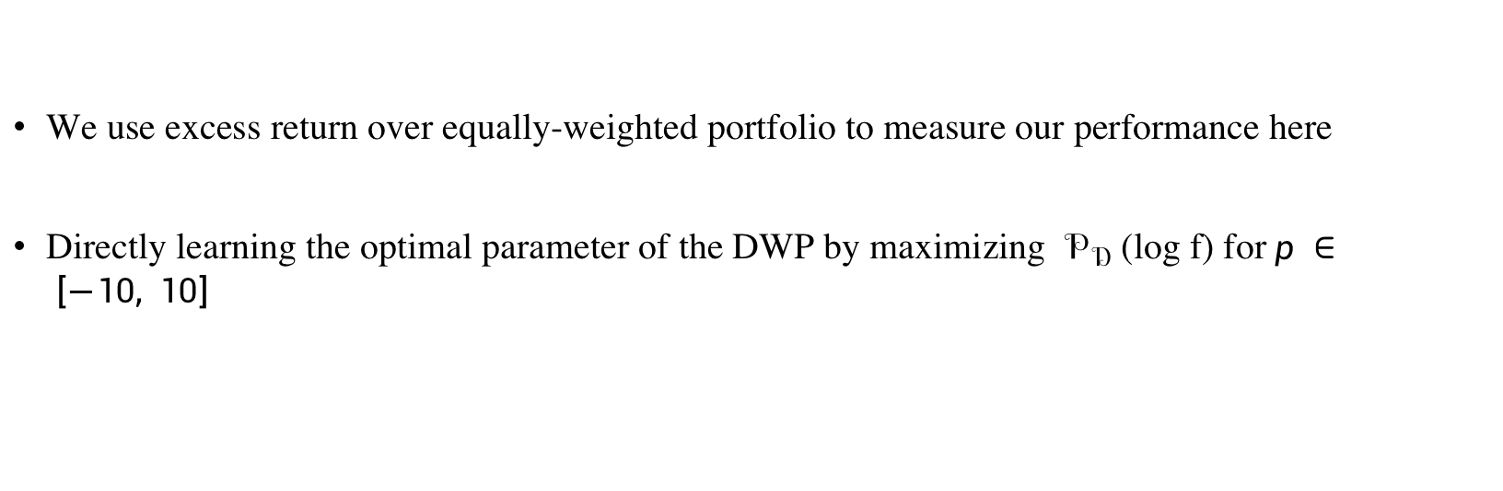
Frequentist parametric
We use excess return over equally-weighted portfolio to measure our performance here
Directly learning the optimal parameter of the DWP by maximizing $𝒫_{𝒟}$ (log f) for$p ∈ \left[−10, 10\right]$

Slide 17
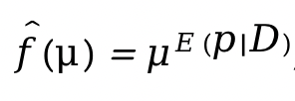
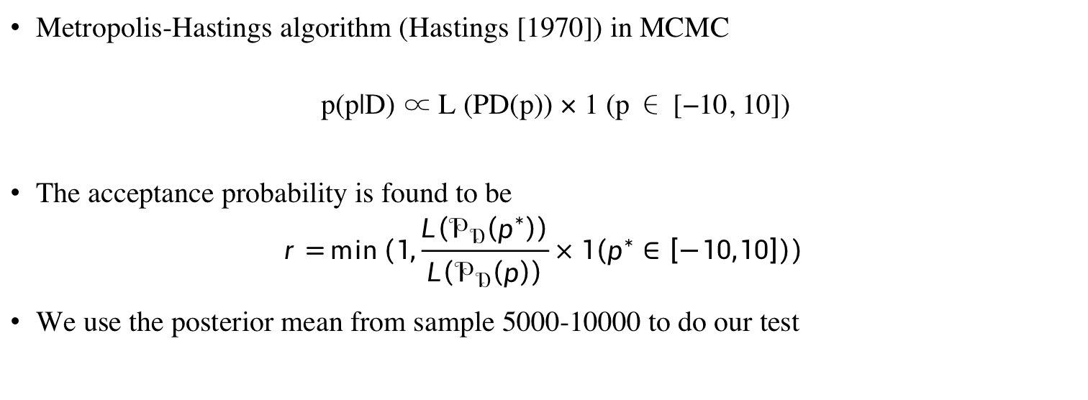
Bayesian parametric
Metropolis-Hastings algorithm (Hastings [1970]) in MCMC
p(p|D) ∝ L (PD(p)) × 1 (p ∈ [−10, 10])
The acceptance probability is found to be
$$r=\min\left(1,\frac{L\left(𝒫_{𝒟}\left(p^{∗}\right)\right)}{L\left(𝒫_{𝒟}\left(p\right)\right)}×1\left(p^{∗}∈\left[−10,10\right]\right)\right)$$
We use the posterior mean from sample 5000-10000 to do our test

Slide 18

Analysis of S&P 500 Constituents for Optimal Portfolio Strategies
Utilized S&P 500 component stocks, accouting for index component changes, for portfolio experiments.
Monthly portfolio adjustments based on Yahoo Finance data from January 2008 to December 2022.
Investment strategies tested over five-year periods, creating six training and testing data subsets.
Performance of various portfolios, including market index, equall-weighted portfolio and diversity-weighted portfolios, assessed using MCMC and functional maximization.

Slide 19
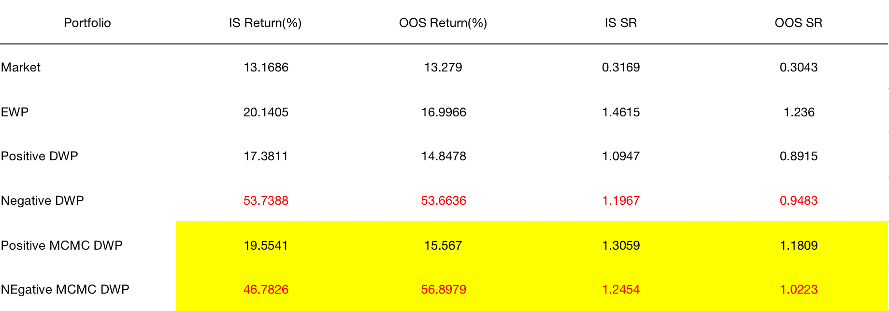

Slide 20
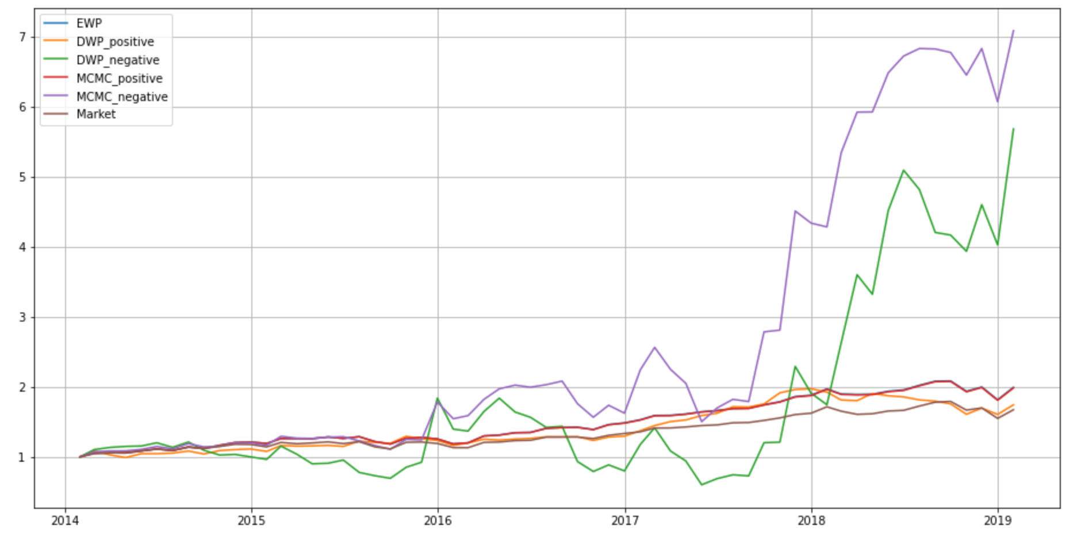
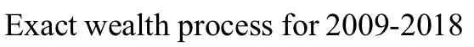

Slide 21
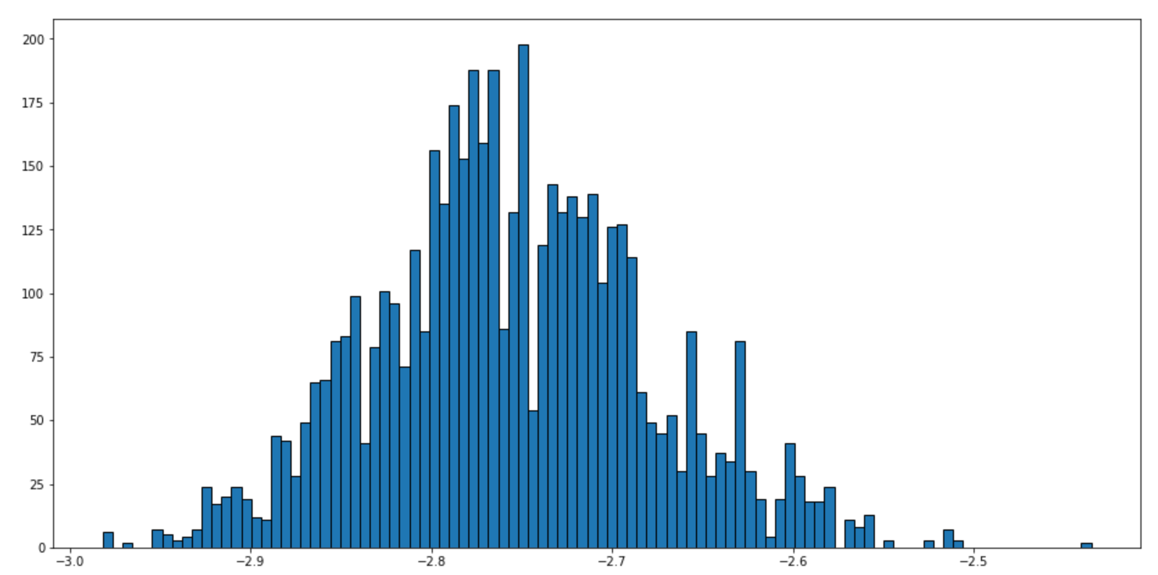

Slide 22
Empirical Findings
Portfolios with negative p indeed outperforms those with positive
Diversity-weighted-portfolio may be poor at risk management
Diversity-weighted-portfolio coming up by MCMC can slightly outperform that using simple maximization

Slide 23
Reference
“Diversity-weighted portfolios with negative parameter” by Alexander Vervuurt, Ioannis Karatzas (2015)
“Stochastic Portfolio Theory: A Machine Learning Perspective” by Yves-Laurent Kom Samo, Alexander Vervuurt (2016)

